Slide 1

Xantrion:
Who We Are, What We Do, and How We Do It
Speaker:
Diana Lara, Recruiting, Xantrion Inc.

Slide 2

Introductions
Diana Lara, Recruiting

Slide 3

Agenda
30minutes | Xantrion: A Managed Service Provider
15 minutes | A Day in the Life
15 minutes | Wrap-up and Final Q&A
Resumes Accepted!
We’re hiring interns and full-time system administrators who are authorized to work in the US
Notes:
SAY
Briefly note where you are on the agenda.
DO
Check to see if there are any questions before moving forward.

Slide 4
Xantrion:
Who We Are, What We Do, and How We Do It
Xantrion: A Managed Service Provider

Slide 5
What is a SMB and MSP?
SMB = Small to Medium Business
  Traditionally under 50-100 for “Small”, under 250-500 for “Medium”
MSP = Managed Service Provider
  Providing services for a monthly fee
  In IT consulting, it’s providing IT support for a monthly contract
  Contrast this to “T&M” or Time and Materials – you only charge the customer for the hours you put in
  Monthly contracts are good
    Us: Recession proof
    Client: IT budget is fixed

Slide 6
What Services Do We Provide?
Monthly Ongoing Services
  The majority of our business is services for which we receive a reliable check each month
    Resolve computer issues for employees
    Find parts and order
    Setup new desktops/laptops/handhelds
    Troubleshoot things like “my computer is slow”
    Handle all server-related issues
One-time services
  Revamp network design (when acquiring a new client)
  High-end projects for companies with in-house IT who have insufficient knowledge/experience

Slide 7
How We Provide Service: A 4-Tiered Approach
Tier 1: Help Desk Engineers
  Provide desktop support and act as dispatchers for complex issues
  Maintain documentation of systems and networks
  Over 50% of issues are addressed at this tier
Tier 2:Associate Consultants
  Proactive monitoring and maintenance of networks and backups
  First point of escalation for complex issues
Tier 3: Consultants
  Account managers, maintain strong relationships with clients
  Plan long-term IT strategy and ensure day-to-day support is smooth
  Second point of escalation for complex issues
Tier 4: Senior Engineers
  Experts in a particular area (networking, virtualization, mail, etc.)
  Brought in to manage bring-ups and implementations
  Final point of escalation for complex issues

Slide 8
Tools We Use
Remote Support
  All client servers are remotely accessible, maintenance doesn’t require an on-site presence.
  Most desktop support is done remotely, minimizing downtime while clients wait for a technician to be dispatched.
Network Monitoring
  Every critical component of client’s network is monitored (servers, firewalls, ISPs, etc.)
  We know about problems before the client does and can work proactively rather than reactively.
Standardization and Virtualization
  After supporting hundreds of clients over the past 10 years, we know what works best. Easier to support standardized environments.
  Replace several outdated servers with one robust server machine hosting several virtual servers. Decreases problems related to hardware failure.

Slide 9
Workflow and Escalation

Slide 10
Questions?

Slide 11
Xantrion:
Who We Are, What We Do, and How We Do It
Day in the Life of a Help Desk Administrator

Slide 12
Example Responsibilities
  Assist clients with desktop issues
  Create and manage user accounts
  Identify and assign appropriate resources for escalated service requests
  Assist consultants with projects as needed
  Shadow consultants
  Learn!

Slide 13
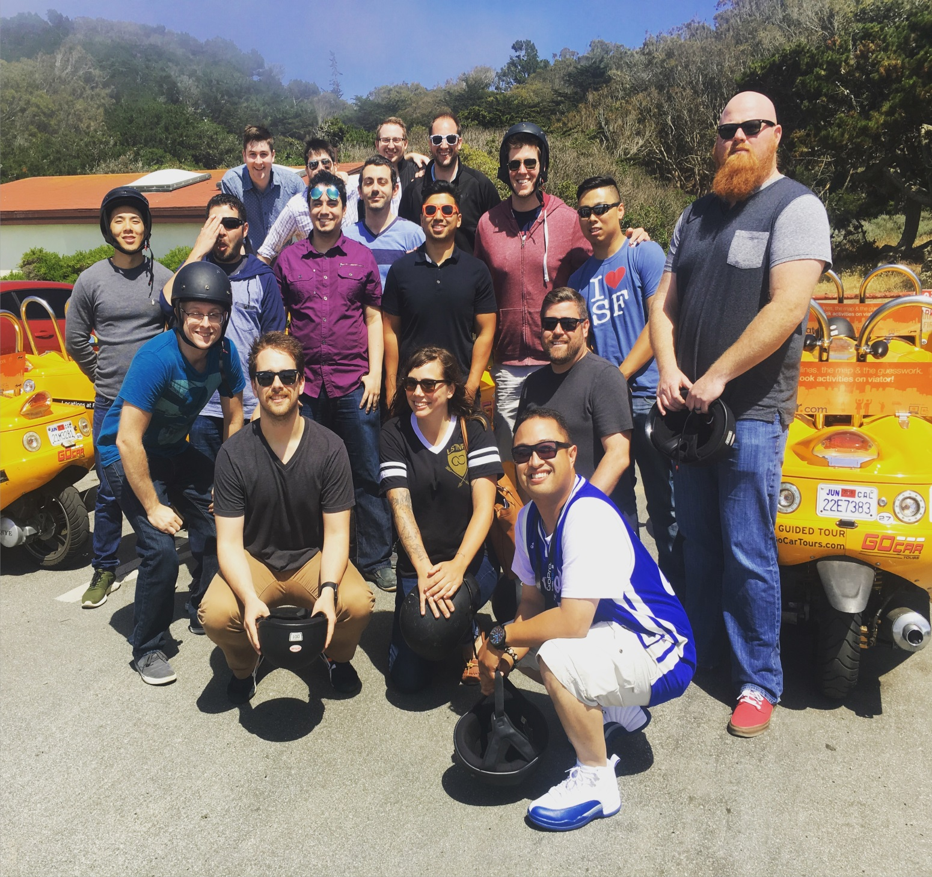
Update:
Service Desk Re-Org
June 2016

Slide 14
Service Desk size and scope expanded to enhance career path and unload consultants
Help Desk is now known as Service Desk.
Titles Changed to “Support Engineer” to better represent work role within the industry
3 tier support model with consistent escalation resources.
Minimize escalations to consultants.
On-site, HQ, and remote Service Desk Techs.
Service Desk handles majority of incident related tickets (break/fix)
Vision in place, but will take time to implement.

Slide 15

Xantrion Engineering Career Paths
Client Strategy
Sr. Consultant
Consultant
Associate Consultant
Service
Sys Admin
Associate Sys Admin
NOC
NOC Specialist
Assoc. NOC Specialist
Project Team
Systems Architect
Service Desk
Support Engineer III
Support Engineer II
Support Engineer I

Slide 16
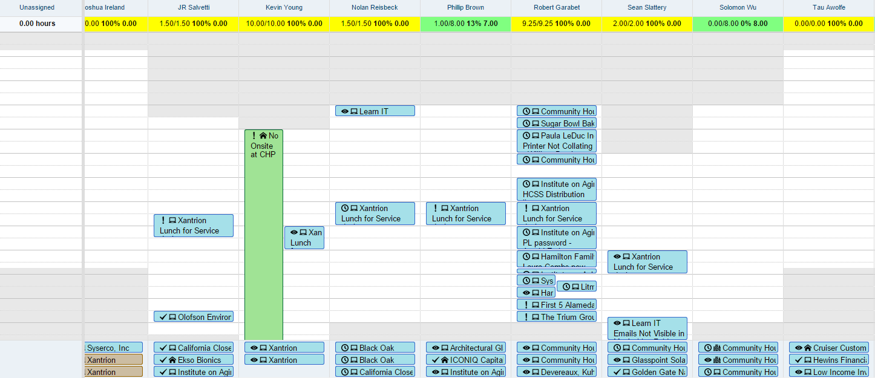
Each person’s daily availability shown, tickets are increasingly assigned by person, day and time.

Slide 17
Service Desk Board changes improve client expectation management and overall efficiency
Isolate tickets that are Break/Fix Incidents.
Meaningful statuses that align with type of work and help identify and get ahead of trends
Workflow rules/email templates for better customer service.
Better metrics

Slide 18
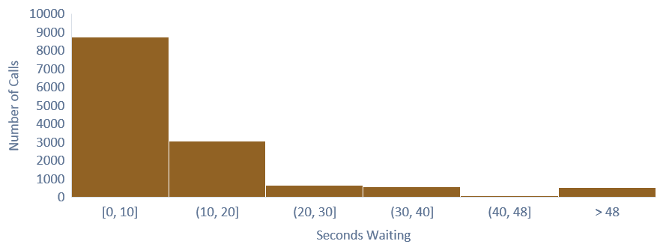
Time to Answer Call: Nov. 2015 to May 2016
92% of Calls are answered in under 30 Seconds
64%
92% before 5th Ring
23%
5%
4%
1%
4%

Slide 19
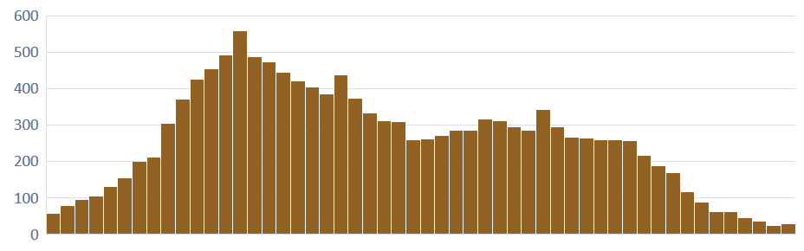
Call Volume by Quarter Hour
Using call volume data to schedule work on e-mail support tickets without risk of interruption
6:00
9:15
1:30
6:45

Slide 20
CSAT/Reporting
Nex.to being used to invite clients to leave feedback when tickets are closed. Allows us to immediately respond to less than perfect situations and praise techs for jobs well done.
Brightgauge being used as a reporting dashboard for up-to-minute stats on:
  Phone System
  ConnectWise
  Nex.to

Slide 21
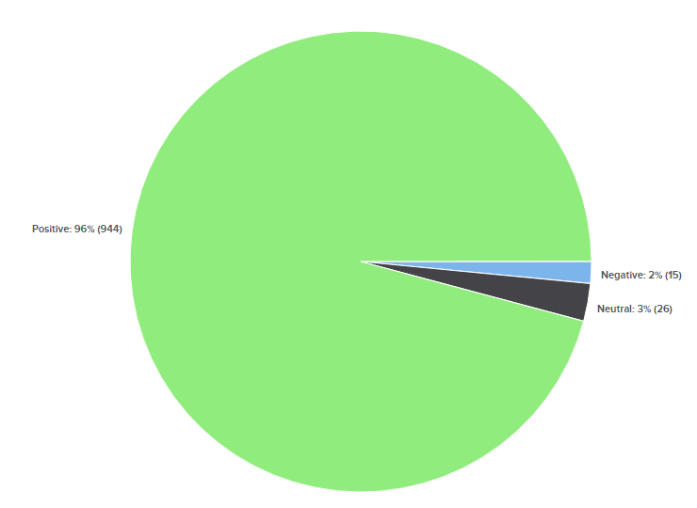
Service Desk CSAT
96% Positive Satisfaction!!

Slide 22
Remote Staff
Starting to hire staff in different time zones.
Having the Service Desk “Follow the Sun”.
Won’t have to ask employees to come into Oakland at 5 AM.
Career path within service desk.
Candidate pool is much larger.
Know a good candidate? Send them our way!

Slide 23
Xantrion Work Environment
  Professional and positive
  Able to see the impact of your work on a daily basis
  Fast paced
  Room to grow
  Learning oriented and continuously evolving
  Everyone has a say in what we do and how we do it
  Team oriented
  Contribution appreciated and outstanding performance rewarded
  Work hard, play hard
  People have the information and tools they need to succeed
Notes:
Examples: impact of work on customers
Process improvement
Training to process to policy and procedure
We support clients in teams, answer technical questions for one another, we cover for each other when out, we rotate on call duties, we have each other’s back in general
Big on thank you and do things like dinner for 2 or hotel stay for outstanding work
We do 1 scheduled company event ea quarter like our Christmas party and a visit to 6 Flags. We also do ad hoc events like A’s games, shuffle board, beers after monthly training.
We use state of the art service management and monitoring software. We provide 4 – 6 weeks of initial training and then ongoing coaching and training there after.

Slide 24
Xantrion Values
Our clients are our reason for being
  Without them, we would not exist
Our people are our business
  If we do nothing other than hire right, we will do well by our clients
  If our people are inspired, they will take the company and it’s community to places we have yet to imagine
Our community is our future
  Our clients, growing businesses, are the key to turning around the US economy
  We are dedicated to being a spring board for our clients

Slide 25
Questions?

Slide 26
Xantrion:
Who We Are, What We Do, and How We Do It
Xantrion Summary, Wrap-up, and Q&A

Slide 27
Xantrion Facts
  Founded in Oakland, CA in 2000
  88% growth between 2006 and 2016
  59 person elite technical team
  420 servers under management and 5,500 end users supported
  Premium partner for major vendors such as Microsoft, Dell, Vmware, Citrix, and Iron Mountain
  Compensation package that includes:
    100% of your healthcare premium for you and your family
    Profit sharing
    Matching 401K plan
    Certification reimbursement
    Monthly in-house training
    Third party training event each year
    17 days PTO

Slide 28
Xantrion People
  Interns and full-time employees
  US based and authorized to work in the US
  90% retention year after year
  Elite team of professionals
    4 year degrees – Information Systems to Film
    Industry certifications
    Like people as much as computers
    Explain technical recommendations in business/layman’s terms
    Go the extra mile to assist clients
    Proactive because they own IT
    Team players
    Take pride in their work because when done well, IT is a spring board for business
“Dave is an EXPERT but he is so humble about it; I have NEVER felt that my questions were in the "Idiot" realm nor has he ever implied that I've overreacted to a situation that was really no big deal. ”

Slide 29
Xantrion Career Opportunities
$95K
$80K
Years
Profit Sharing, Benefits & Training
$65K
$47K
Positive Computer Experience
Notes:
Because we are growing and have a clear cut career ladder, we provide more opportunities than most businesses. Ex = Catherine. Consultant for a year and a half prior to being promoted to Ops mgr.
Because we are a consulting company that works with growing businesses we are the perfect place to quickly learn and stay abreast of the latest technology. We implement new systems for a variety of customers on a regular basis which allows us to expand our experience and skill set. Last but not least, you get to work with and learn from some of the best IT pros in the business.

Slide 30
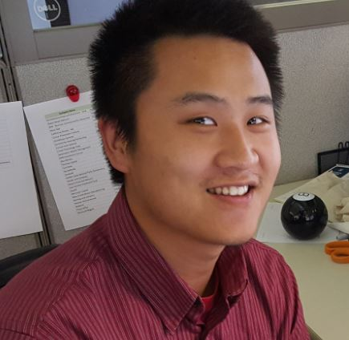
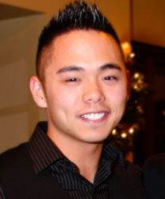
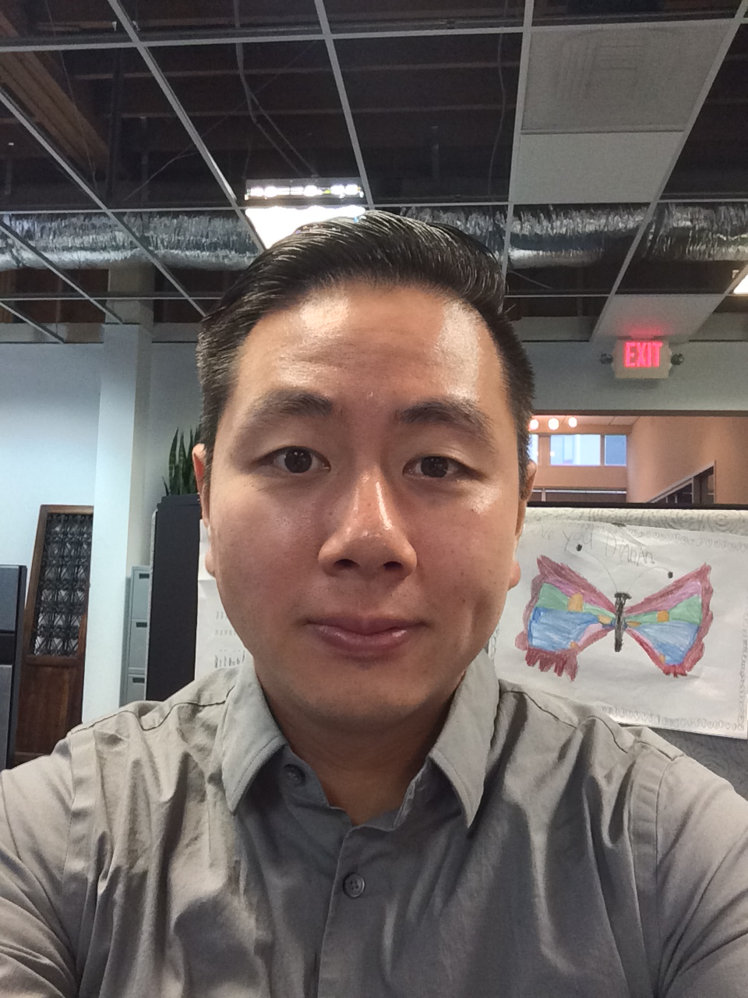
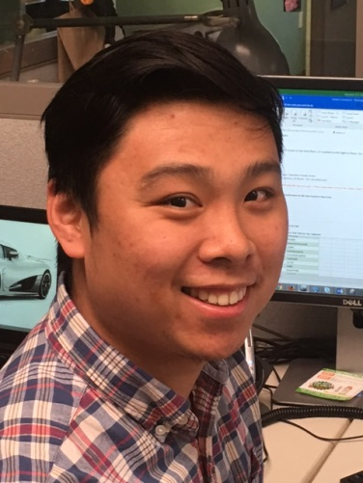
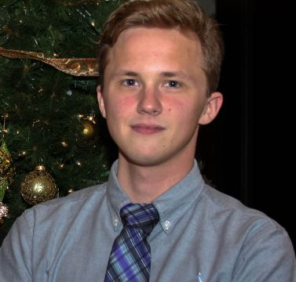
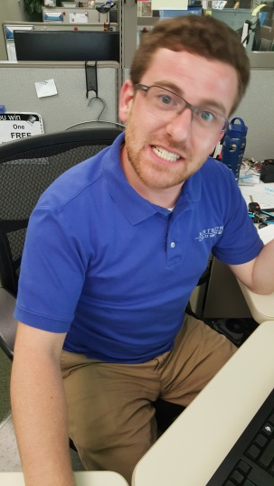
Former UCSC graduates
Solomon Wu
Austin Ngo
Jerry
Lee
James Lin
Jack Wolfe
Sean Cameron

Slide 31
Questions?

Slide 32
Resumes?
We’re hiring summer interns and full-time system administrators who are authorized to work in the US

